Slide 1
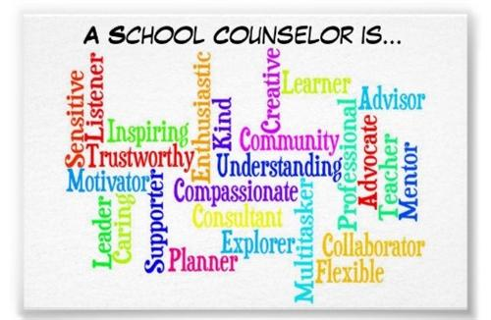
WELCOME!
Notes:
Ms. Kennerson

Slide 2
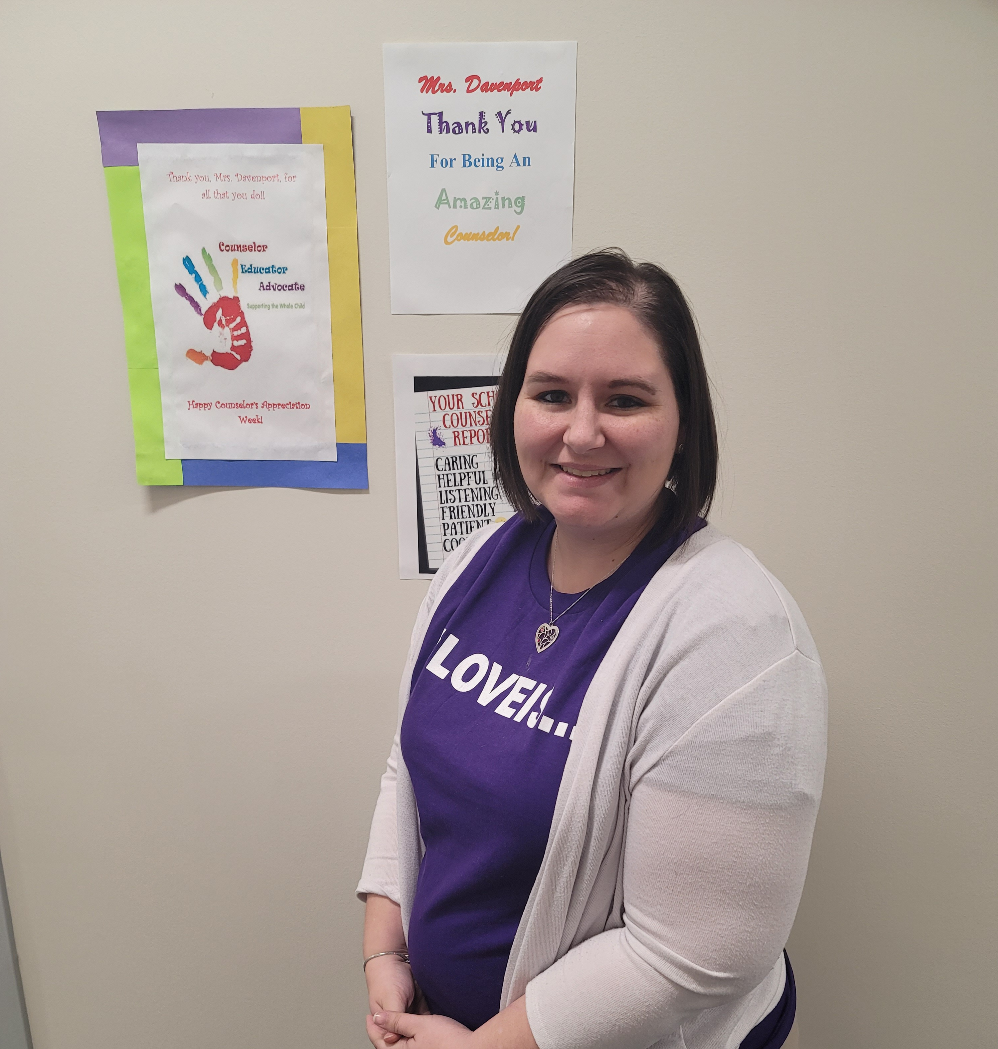
Mrs. Davenport
Notes:
Ms. Kennerson

Slide 3
The Role of the School Counselor
School counselors are individuals who help students succeed in school by helping them form healthy goals, mindsets and behaviors.
- American School Counselor Association
Notes:
Mrs. Davenport

Slide 4
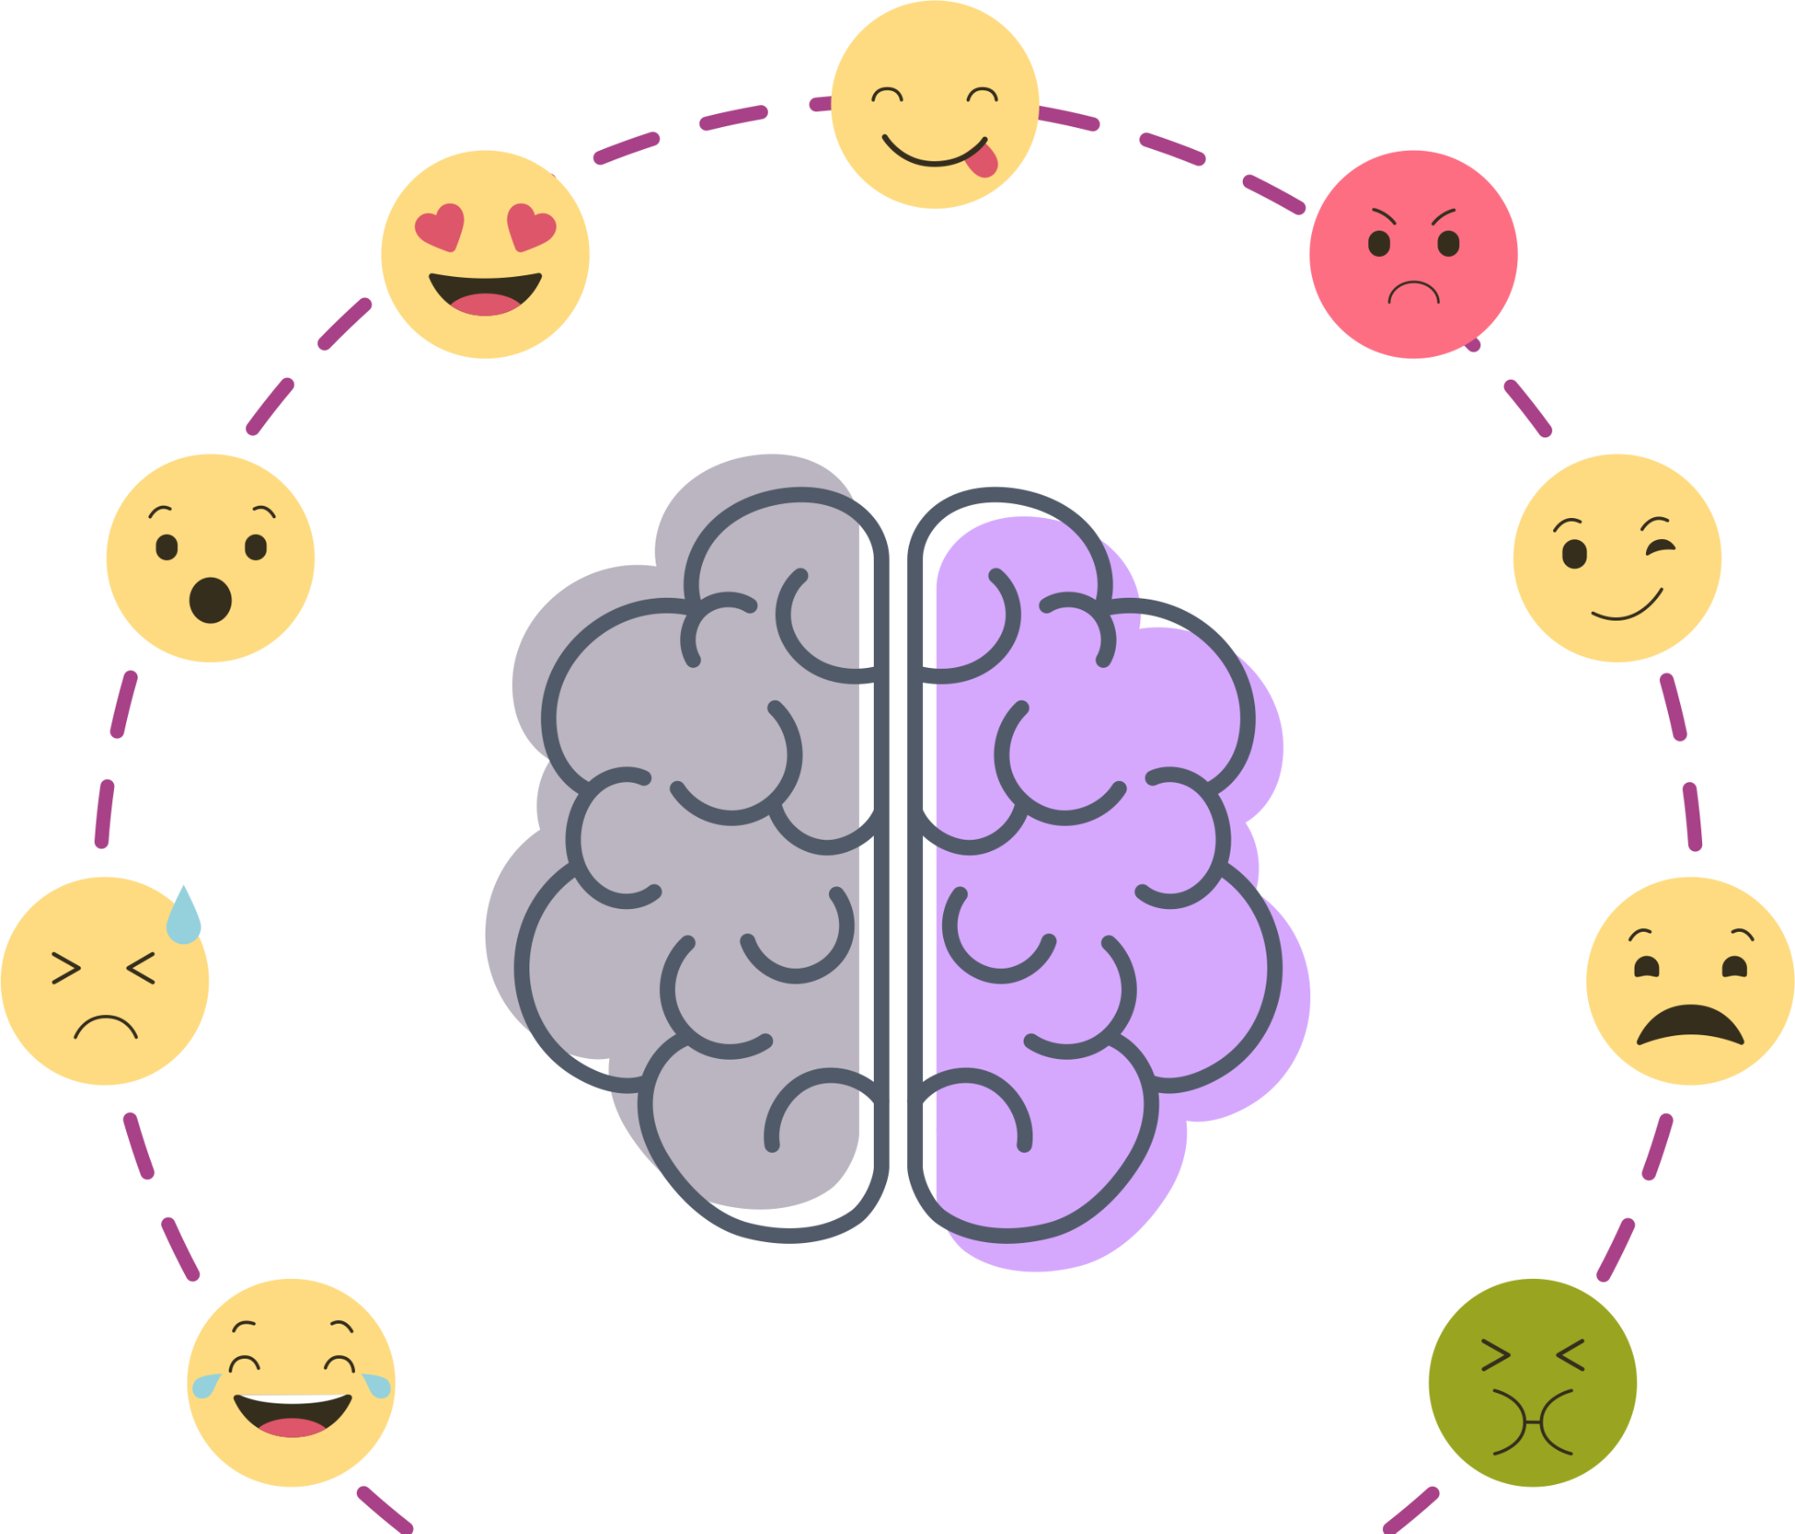
How can I help?
Support Services
SEL – Social Emotional Learning
Academic Success
Notes:
Mrs. Davenport

Slide 5
Support Services
What is it?
How can my student get these services?
Classroom Lessons
Small Group
Individual Counseling and Planning
Goal Setting
Responsive Services
Student request
Teacher/Administration Referral
Call or email us with your concerns
Notes:
Ms. Kennerson

Slide 6
SEL
Social Emotional Learning
All young people and adults acquire AND apply the knowledge, skills and attitudes
Develop healthy identities
Manage emotions
Achieve personal and collective goals
Feel and show empathy for others
Create supportive and positive relationships
Make responsible decisions
Notes:
Mrs. Davenport

Slide 7
Academic Success
Test Taking and Study Skills
Individual Goal Setting
Resources
Notes:
Ms. Kennerson

Slide 8
Notes:
Mrs. Davenport

